Slide 1

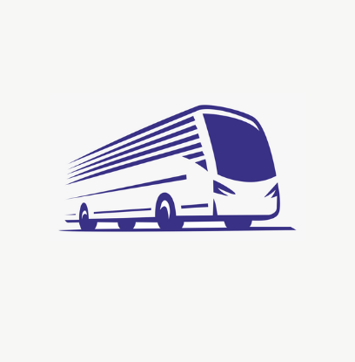
TEAM OASIS
TEAM NO: 25
TANVIRAJ JAYAM, TEJAS MYSORE HARISH,
VARUN HARIKRISHNAN, VENNELA REDDY

Slide 2
Problem Statement
Real-time passenger stop verification and seamless on-the-spot ticket booking system, enhancing both user experience and operational efficiency in urban transportation.
Current Situation:
1
The need for ‘change’
A painstaking experience for all parties involved to stand in a crowded bus exchanging money.
2
Exit tracking
There is no definitive way to ensure that a person gets off at the spot they paid for.

Slide 3
Our Approach
Cashless Booking: An app with the ability to allow passengers to book tickets for their routes via online methods, as we move to a more digital India.
Simplified Interactions with the Conductor: Upon payment, a QR Code will be generated to be scanned by the conductor to approve your ticket.

Slide 4
Our Approach
Exit Tracking: By using passenger’s location and the bus's location, we can track when the passenger exits the bus, thus ensuring that they are not cheating the system.
Fines for those who do not adhere to system: A person is forced to pay a fine the next time they book if they repeatedly try to get off at a stop after their booked stop.

Slide 5
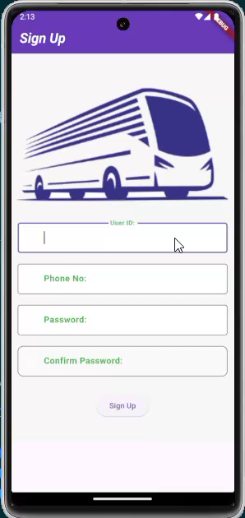
Flow of the app

Slide 6
Flow of the app
After payment, a QR Code is generated. This QR Code will be scanned by the conductor in the bus. When the passenger is getting down, they will simply click ‘End Ride’ and the ride is stopped. Location tracking is used to verify that the person is not moving with the bus.
If passenger is seen to travelling with the bus beyond their chosen stop, they are alerted on the app.

Slide 7
Business Model
Solves a problem that hasn’t been addressed in the market
Scalable - Can easily be used for any city’s bus routes with the aid of the government
Paperless Mode - No paper is being wasted in this method. Also the ticket history is stored in a database if ever needed.

Slide 8
Thank You!

